Slide 1
Florida Government Financial Officer Association Treasury Management Payables Solutions February 5th, 2016

Slide 2
Treasury Management Services

Slide 3
Featured Payables Solutions

Slide 4
Procurement and T&E Cards

Slide 5
Procurement and T & E Cards

Slide 7
Procurement and T & E Cards

Slide 8
Commercial Payment Trends

Slide 9
Evolving Commercial Card Solutions

Slide 11
ePayables

Slide 12
ePayables – Introduction

Slide 13
ePayables – Solutions Overview

Slide 14
ePayables – Pull Pay

Slide 15
Pull Pay / Virtual Card Workflow

Slide 16
ePayables – Push Pay

Slide 17
Push Pay / BIP Workflow

Slide 18
Push Pay / BIP – Buyer Incentives

Slide 19
Push Pay / BIP – Supplier Incentives

Slide 20
Push Pay / BIP – Control Interchange

Slide 21
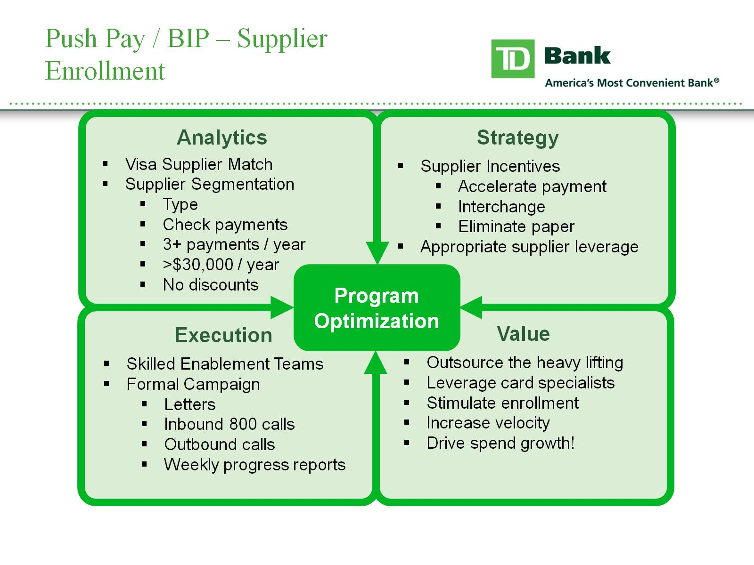
Push Pay / BIP – Supplier Enrollment

Slide 22
Successful Program Optimization

Slide 23
Visa Supplier Enablement Service

Slide 24
Supplier Acceptance Drivers

Slide 25
B2B Payment Strategy

Slide 26
Integrated Payables

Slide 27
AP Outsourcing – Popular Trend

Slide 28
Current AP Environment

Slide 29
Integrated Payables Introduction

Slide 30
Integrated Payables Workflow

Slide 31
Material Value for AP

Slide 32
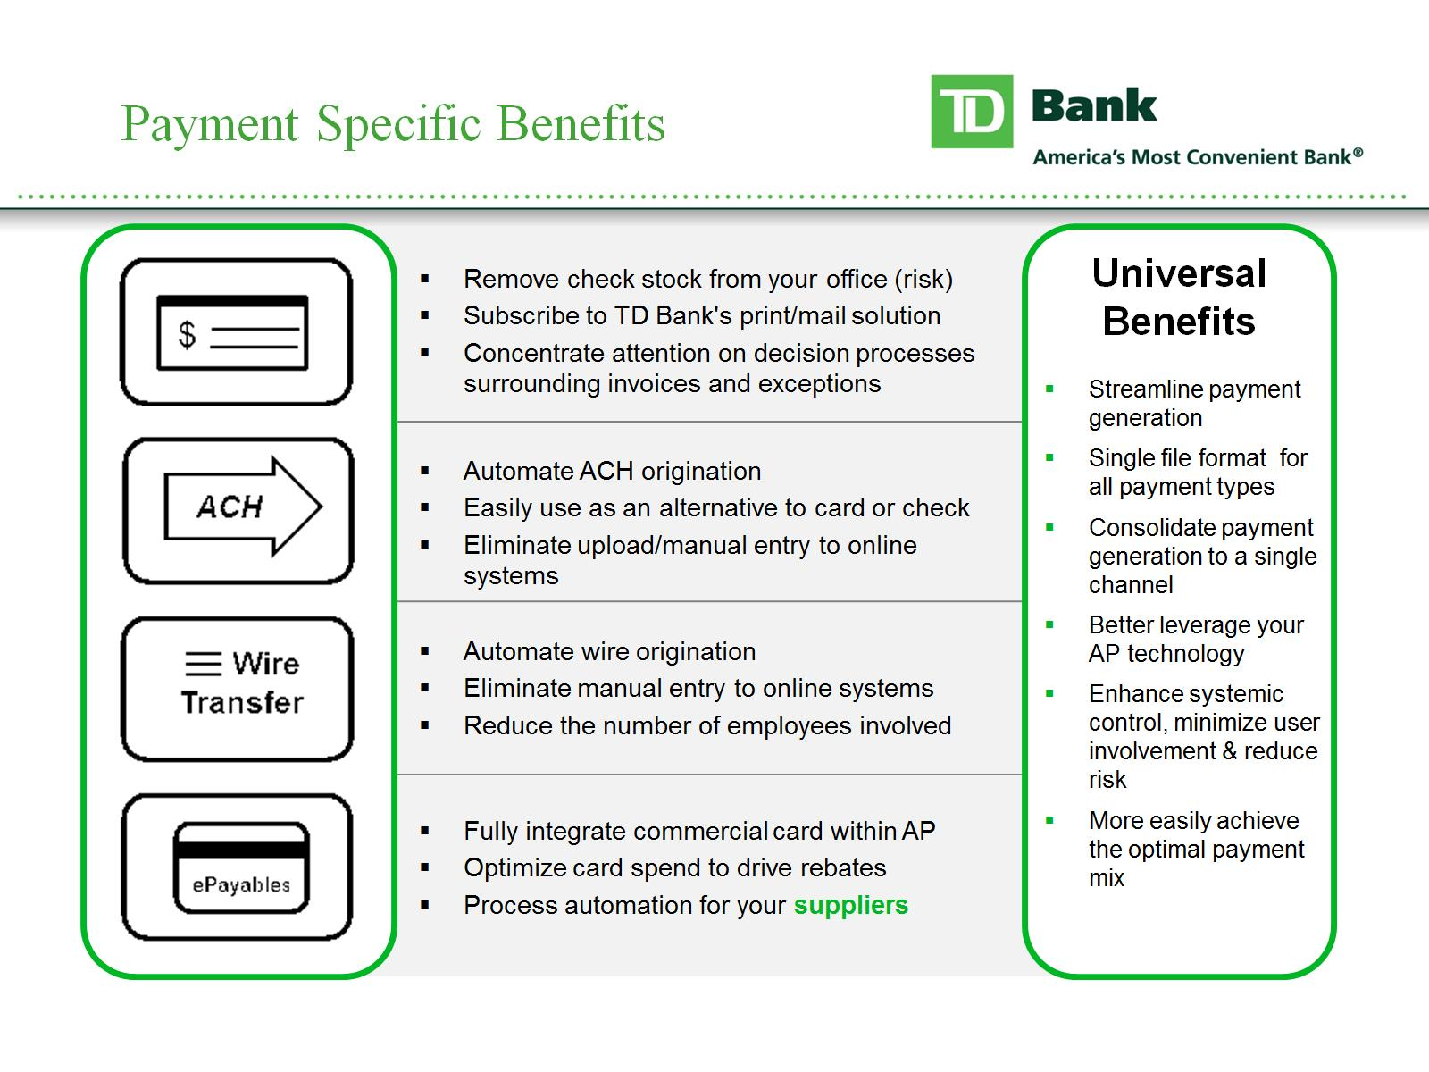
Payment Specific Benefits

Slide 33
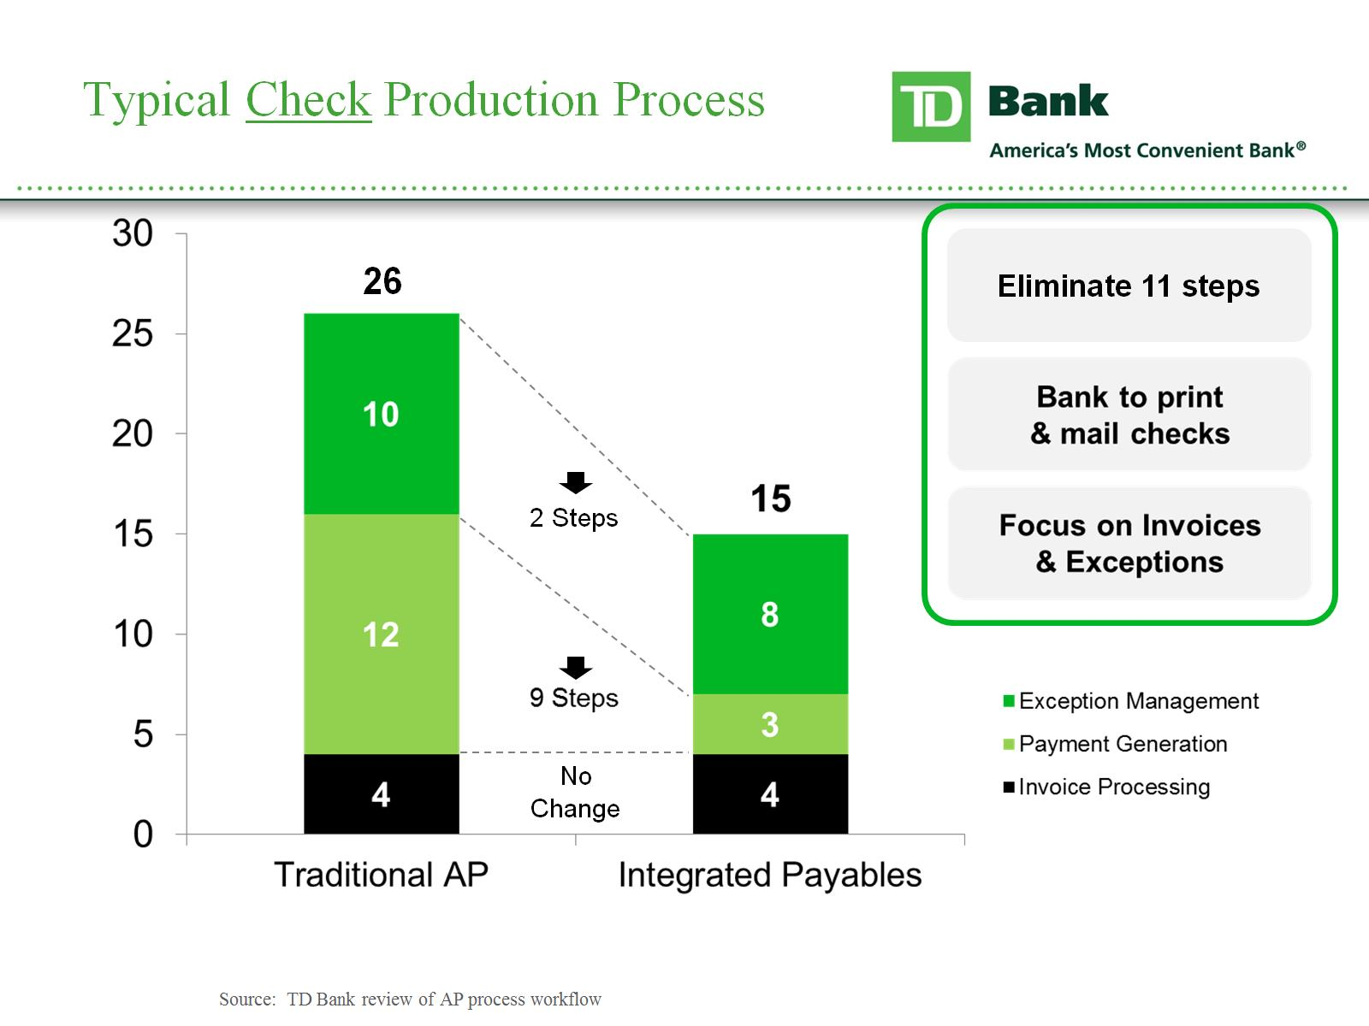
Typical Check Production Process

Slide 34
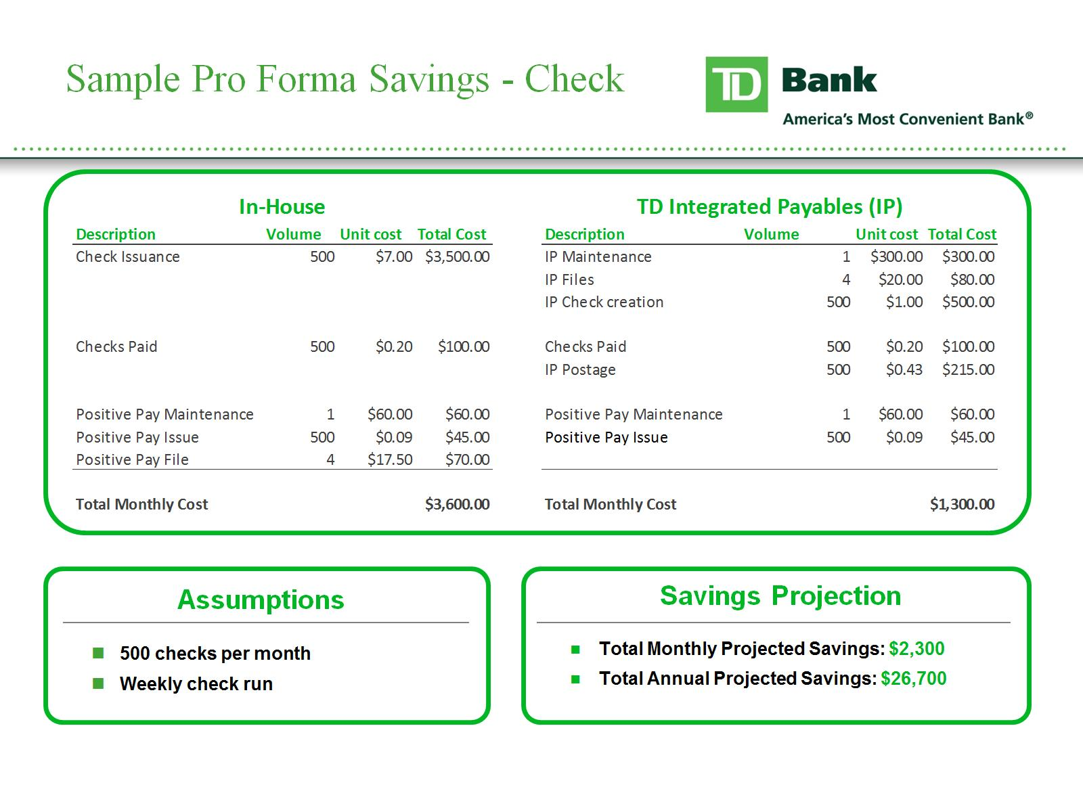
Sample Pro Forma Savings - Check

Slide 35
Questions and Answers

