Slide 1
Best of Accounting Complexities – FGFOA Central Florida Chapter Spring Meeting
By Andrew Laflin, CPA
Principal, CliftonLarsonAllen LLP

Slide 2
Learning Objectives
This session will provide answers to a series of questions that present complex and often overlooked accounting and financial reporting issues. Examples include the following:
Debt Issuance in a Governmental Fund
Capital Asset Transfer Between Funds
Restricted Net Position & Fund Balance
Capital Outlay & Capital Asset Additions
Revenue Recognition for Property Taxes
Capitalized Interest

Slide 3
Question #1 Debt Issuance in Gov’t Fund
On March 10, 2016, the City of Kissimmee issued $7,500,000 of general obligation bonds to finance the construction of a new recreation center. Debt issuance costs were $60,000, and the bonds were issued at a discount of $282,000. The bond discount and $44,000 of underwriters’ fees, bond insurance, and rating agency fees were deducted from the bond proceeds. A month later, the City paid the remaining $16,000 of issuance costs upon receiving an invoice from bond counsel. The initial debt service payment is due on 11/10/16, which includes $150,000 of interest.

Slide 4
Question #1 Debt Issuance in Gov’t Fund
Within the debt service fund on the governmental fund financial statements, the City recorded $7,174,000 ($7,500,000 minus 282,000 minus $44,000) as an other financing source. The remaining $16,000 of issuance costs was recorded as an expenditure when paid. Furthermore, since the debt service payment was to be made within 60 days after year end, the City recorded accrued interest of $125,000 relating to the period 3/10/16 to 9/30/16. Did the City record this correctly?

Slide 5
Answer #1 Debt Issuance in Gov’t Fund
GASB 34, para 87 requires bond issuance costs to be reported as expenditures, not as other financing uses or netted against bond proceeds, on the closing date
GASB 34, para 88, as amended by GASB 37, para 16, requires issuance discounts and premiums related to general long term debt to be reported as separate financing sources and uses

Slide 6
Answer #1 Debt Issuance in Gov’t Fund
GASBI No. 6, para 13 states that a government may report a liability and expenditure for debt service on general long-term debt before it is due for payment only if:
“Dedicated” financial resources have been accumulated in a debt service fund AND
The debt service is due and payable within one to several days after year end but no more than one month after year end

Slide 7
Question #2 – Capital Asset Transfer
Seminole County is transferring vehicles and equipment out of one fund and into another. The assets have an original cost of $1,340,265 and accumulated depreciation of $766,244.
What would be the entries to record this transfer from…
One enterprise fund to another enterprise fund?
An internal service fund to an enterprise fund?
A governmental fund to an enterprise fund?

Slide 8
Answer #2 – Capital Asset Transfer
7.74.4. Q—How should the reassignment of a capital asset between an enterprise fund and governmental activities be reported?
A—If the assets reassigned from governmental activities to an enterprise fund are capital assets, the transaction is not “interfund” because it involves only one fund; consequently, the enterprise fund would report the receipt of the capital assets as a capital contribution from governmental activities (in the last section of the statement of revenues, expenses, and changes in net position). In the reverse situation, in which a capital asset is reassigned from an enterprise fund to governmental activities, the disposal of the capital asset would be reported by the enterprise fund as a nonoperating expense. In either case, governmental funds would not report the event because there has been no flow of current financial resources. In the statement of activities, the reassignment of the capital asset between governmental and business-type activities would be reported as a transfer, requiring a reconciling item in the governmental funds' reconciliation because a difference is created between the change in fund balances and the change in total net position.

Slide 9
Question #3 – Restricted Fund Balance/Net Position
The City of Palmetto has the following funds that contain restricted fund balance at September 30, 2016:
CRA Fund (entire fund balance restricted) to redevelop the a CRA district = $360,542
Street Improvement Fund (capital projects fund that has restricted, committed, and assigned fund balance) = $545,282 restricted. This fund also had unspent bond proceeds totaling $132,365.
Debt Service Fund (legally required to set up sinking fund to accumulate cash to pay off debt at maturity) = $229,170

Slide 10
Question #3 – Restricted Fund Balance/Net Position
The City also has the following modified accrual / full accrual differences to consider:
Capital assets, net (general gov’t activities) = 22,068,412
Bonds & notes payable (general gov’t activities) = 5,417,633
Pension related amounts and compensated absences allocated across funds based on headcount: 3 employees in Community Redevelopment Fund; zero employees in Street Improvement Fund & Debt Service Fund
Grant revenue in Street Improvement Fund awarded in FY ’16, collected in January 2017 (City’s availability criterion is within 60 days after year end), and spent in FY ‘17 & FY ‘18 (eligibility criteria have been met) = $165,438
Accrued interest payable in gov’t activities (payment recorded in debt service fund) = $123,114

Slide 11
Question #3 – Restricted Fund Balance/Net Position
The City of Palmetto participates in the Florida Retirement System. It has 26 employees, and 18 of those employees participate in the traditional pension plan, while the remaining 8 employees participate in the Investment Plan (defined contribution plan option). All employees participate in the health insurance subsidy plan ($150 per month stipend upon retirement). As of June 30, 2016, the City’s net pension liability consisted of the following:
Amount | FRS Pension (18 employees ) | HIS Plan (26 employees)
Net Pension Liability | $1,472,770 | $750,660
Deferred Outflows of Resources | $964,240 | $94,285
Deferred Inflows of Resources | $905,353 | $0
Contributions 7/1/15 – 6/30/16 | $278,000 | $28,137
Contributions Subsequent to PY Measurement Date | $61,191 | $6,228
Contributions Subsequent to CY Measurement Date | $67,791 | $8,843

Slide 12
Question #3 – Restricted Fund Balance/Net Position
Compensated Absences:
FRS Pension Plan (multi-employer cost sharing defined benefit) employees (6.8% employer contribution) - 18 employees total:
Liability: # of hours x applicable wage rate = $663,540
FRS Investment Plan (defined contribution) employees (3.3% employer contribution) - 8 employees total:
Liability: # of hours x applicable wage rate = $214,680
Comp Absences & Net Pension Liability:
Two CRA employees are in the FRS traditional pension plan; one CRA employee is in the FRS Investment plan

Slide 13
Question #3 – Restricted Fund Balance/Net Position
The City also is partially self-funded for health-related benefits for its employees. The City has a Medical Self Insurance Fund that reports claim activity within this plan. At September 30, 2016, claim liability (including IBNR) was $334,615. The City is also required under an escrow agreement with the medical benefits claims processor to establish a deposit account with this TPA that maintains a balance of $200,000 that must constantly be replenished to that level.

Slide 14
Answer #3 – Restricted Fund Balance/Net Position
GASBS 16, para. 11: an additional accrual should be made for salary-related payments such as the employer's share of social security and Medicare taxes and the employer's contribution to a defined contribution or cost-sharing multiple-employer defined benefit pension plan (WAIT! That’s been amended; see next slide)
GASB Implementation Guide Ch. Z.16.2: recognize governmental fund liability to the extent that the liability has matured (come due for payment) each period. Payments come due each period upon the occurrence of relevant events such as employee resignations and retirements

Slide 15
Answer #3 – Restricted Fund Balance/Net Position
5.255.1. Q—If an employer is required to include amounts paid for compensated absences balances in the amount of payroll on which the employer's contributions to a defined benefit pension plan is based, should the employer accrue the anticipated amounts as a liability for salary-related payments in conformity with the requirements of Statement No. 16, Accounting for Compensated Absences, paragraph 11?
A—No. The employer's additional contributions to the pension plan that are expected to arise as a result of the payment of compensated absences should not be accrued as an additional liability under Statement 16. Instead, the pension benefits, if any, that are expected to arise as a result of the projected payment of the compensated absences to the employee should be included in the projection of benefit payments for purposes of Statement 68 and, therefore, would be included in the net pension liability. Payments to the pension plan that are made as a result of the compensated absence would be recognized as an increase in the pension plan's fiduciary net position in the period in which the payments are due and would, at that time, reduce the employer's net pension liability.

Slide 16
Answer #3 – Restricted Fund Balance/Net Position
7.24.5. Q—A general state statute pertaining to local government finances requires that “revenues derived from a fee or charge shall not be used for any purpose other than that for which the fee or charge was imposed.” If certain fees of a local government in that state have been charged for the purpose of future infrastructure replacement, should those accumulated fees be reported as restricted net position in the statement of net position?
A—Yes. The general statute applies to all jurisdictions in the state and creates a legally enforceable restriction on the use of resources raised through fees and charges. Therefore, in this example, the residual net position should be displayed in a restricted net position account.

Slide 17
Answer #3 – Restricted Fund Balance/Net Position
GASBS 54 para 8: Except as provided for in paragraph 7, amounts that are restricted to specific purposes, pursuant to the definition of restricted in paragraph 34 of Statement 34, as amended by Statement No. 46, Net Assets Restricted by Enabling Legislation, should be reported as restricted fund balance. Fund balance should be reported as restricted when constraints placed on the use of resources are either:
a. Externally imposed by creditors (such as through debt covenants), grantors, contributors, or laws or regulations of other governments; or
b. Imposed by law through constitutional provisions or enabling legislation.

Slide 18
Answer #3 – Restricted Fund Balance/Net Position
Z.54.10. Q—Should the amount reported in governmental funds as restricted fund balance equal the amount reported as restricted net position for governmental activities in the government-wide statement of net position?
A—There are three reasons why those amounts will generally be different. First, the principal amount of a permanent fund is classified as nonspendable fund balance in the governmental fund financial statements but is included in restricted net position in the government-wide statement of net position. Second, reconciling items that represent basis of accounting differences may cause the amounts to be different. And, finally, internal service fund net position are generally included with governmental activities.

Slide 19
Answer #3 – Restricted Fund Balance/Net Position
7.22.9. Q—A government accrues and reports a long-term liability for accretion of interest on deep-discount (capital appreciation) debt that was issued for the construction of general governmental capital assets. Which component of net position should be reduced by the liability?
A—Accrued interest on any capital-related debt, including deep-discount debt, generally should not be included in the computation of the net investment in capital assets component of net position. The amount of the “borrowing attributable to the acquisition, construction, or improvement” of a capital asset is the proceeds, rather than the total amount, including interest, that will be paid at maturity. Generally, the accrued interest liability would be included in unrestricted net position. However, if the government has established a “sinking” fund to accumulate cash to pay off the debt at maturity, the accrued interest would be included in (reduce) the same component of net position as the sinking fund resources.

Slide 20
Answer #3 – Restricted Fund Balance/Net Position
Restricted Fund Balance: $1,134,994
Capital Assets, Net: N/A
Bonds & Notes Payable: N/A
Net Pension Liability ($250,256)
Deferred Outflow of Resources: $118,017
Deferred Inflow of Resources: ($100,595)
Compensated Absences: ($109,140)
Unavailable Revenues: $165,438
Unspent Debt Proceeds: ($132,365)
Accrued Interest Payable: ($123,114)
Restricted Net Position – IS Fund: $200,000
Restricted Net Position: $902,979

Slide 21
Answer #3 – Restricted Fund Balance/Net Position
7.24.8. Q—In computing the restricted component of net position, are governments required to “close” nominal accounts into that component? That is, is it necessary to account for the change in the net position balance by adding restricted revenues and deducting expenses incurred for the specified purposes?
A—No. Statement 34, as amended, follows a change in the total net position approach and does not require presentation of a statement of changes in the components of net position, nor does it require disclosure of the changes in restricted net position. The concept of restricted net position focuses on balances rather than transactions. Restricted net position is composed of restricted assets, reduced by reported claims against those assets. Therefore, if a government has net position at year-end that is subject to a legally enforceable restriction on its use, that net position should be reported as restricted in the statement of net position.

Slide 22
Question #4 – Capital Outlay
Lake County had the following capital-related activity in its governmental funds (capitalization threshold is $5,000):
Land purchase in general fund - $350,000
Purchase of signage in CRA fund - $75,325
Donated infrastructure in general fund - $673,522
Acquisition of street sweeper through a noncancelable lease in street improvement fund - $130,565
Purchase of 15 Microsoft tablets in general fund at $400 each - $6,000
Street resurfacing project in progress in street improvement fund - $256,852
What is the County’s capital outlay balance in its governmental funds? What is the total amount of capital asset additions?

Slide 23
Question #4 – Capital Outlay
What about the lease on the street sweeper?
Lessor’s implicit rate on the lease is 6%
Requires no down payment and five equal annual payments of $26,113
Street sweepers are considered to have a 7 year life
Title passes to the County at the end of the lease
The County’s incremental borrowing rate for similar financing arrangements is 4%

Slide 24
Answer #4 – Capital Outlay
GASBS 68, para 213: If at its inception a lease meets one or more of the following four criteria, the lease should be classified as a capital lease by the lessee. Otherwise, it should be classified as an operating lease.
The lease transfers ownership of the property to the lessee by the end of the lease term
The lease contains a bargain purchase option
The lease term is equal to 75 percent or more of the estimated economic life of the leased property
The present value at the beginning of the lease term of the minimum lease payments, excluding that portion of the payments representing executory costs such as insurance and maintenance to be paid by the lessor, including any gain thereon, equals or exceeds 90 percent of the excess of the fair value of the leased property to the lessor at the inception of the lease

Slide 25
Answer #4 – Capital Outlay
GASBS 68, para 213: A lessee should compute the present value of the minimum lease payments using its incremental borrowing rate, unless (1) it is practicable to obtain the implicit rate computed by the lessor and (2) the implicit rate computed by the lessor is less than the lessee's incremental borrowing rate. If both of those conditions are met, the lessee should use the implicit rate.

Slide 26
Answer #4 – Capital Outlay
GASB 68, para 213: A lessee should compute the present value of the minimum lease payments using its incremental borrowing rate, unless (1) it is practicable to obtain the implicit rate computed by the lessor and (2) the implicit rate computed by the lessor is less than the lessee's incremental borrowing rate. If both of those conditions are met, the lessee should use the implicit rate.

Slide 27
Answer #4 – Capital Outlay
GASBS 68, para 217: The asset recorded under a capital lease should be amortized as follows:
If the lease meets the criterion of either paragraph 213a or 213b, the asset should be amortized in a manner consistent with the lessee's normal depreciation policy for owned assets
If the lease does not meet either criterion 213a or 213b, the asset should be amortized in a manner consistent with the lessee's normal depreciation policy except that the period of amortization should be the lease term. The asset should be amortized to its expected value, if any, to the lessee at the end of the lease term.

Slide 28
Answer #4 – Capital Outlay
To summarize, at the inception of a capital lease, the capital asset and lease liability recorded by the lessee are the same. A two-part computation is required:
The present value of minimum lease payments scheduled during the lease term is computed using the lower of the lessee's incremental borrowing rate or, if known, the implicit rate computed by the lessor. • The present value of minimum lease payments is compared with the fair value of the leased asset at the inception of the lease, and the lower amount is used to record the asset and liability.

Slide 29
Answer #4 – Capital Outlay
7.9.8. Q—Should a government's capitalization policy be applied only to individual assets or can it be applied to a group of assets acquired together? Consider a government that has established a capitalization threshold of $5,000 for equipment. If the government purchases 100 computers costing $1,500 each, should the computers be capitalized?
A—Authoritative pronouncements do not address the manner in which a capitalization policy should be established and applied. Capitalization policies adopted by governments include many considerations such as finding an appropriate balance between ensuring that all significant capital assets, collectively, are capitalized and minimizing the cost of record keeping for capital assets. It may be appropriate for a government to establish a capitalization policy that would require capitalization of certain types of assets whose individual acquisition costs are less than the threshold for an individual asset. Computers, classroom furniture, and library books are assets that may not meet the capitalization policy on an individual basis, yet might be considered material collectively.

Slide 30
Answer #4 – Capital Outlay

Slide 31
Answer #4 – Capital Outlay
Entry in general fund (or in debt service fund, if required by legal or contractual mandate):
DR: Expenditure – debt service principal $21,463
DR: Expenditure – debt service interest $4,650
CR: Cash $26,113
Entry in general capital assets ledger:
DR: Vehicle – street sweeper $116,250
CR: Capital lease obligation $116,250

Slide 32
Answer #4 – Capital Outlay

Slide 33
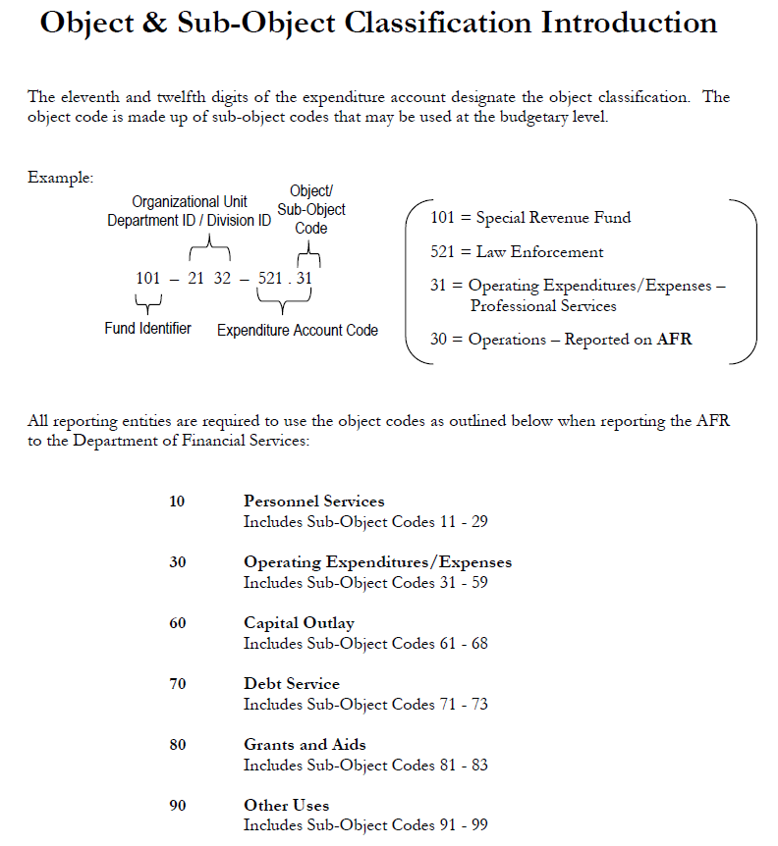
Answer #4 – Capital Outlay

Slide 34
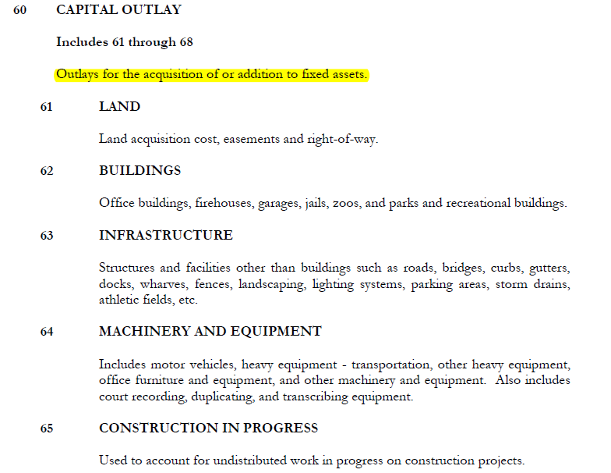
Answer #4 – Capital Outlay

Slide 35
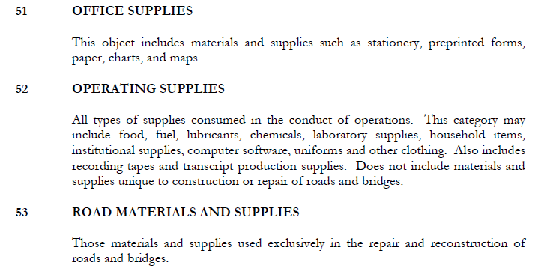
Answer #4 – Capital Outlay

Slide 36
Answer #4 – Capital Outlay
Capital outlay computation:
Gov’t Activities Capital Asset Additions = $350,000 land purchase + $75,325 signage purchase + $673,522 donated infrastructure + $116,250 street sweeper capital lease + $0 Microsoft tablets + $256,852 CIP project
Less: Reconciling Items
(673,522) donated infrastructure
(116,250) capital lease
Total Capital Outlay – Governmental Funds $682,177

Slide 37
Question #5 – Property Tax Revenues
Orange County taxpayers may choose to pay their taxes through a quarterly Installment Payment Plan. To qualify for the plan, the taxpayer must be current on their taxes and their prior year taxes must exceed $100.00. Taxpayers must complete and return the Installment Payment Plan Application no later than May 1.

Slide 38
Question #5 – Property Tax Revenues
The first and second installments are based on ¼ of the previous year’s taxes. The third and four installments are ½ of the remaining actual tax liability for the current year.
1st Installment – ¼ of the total estimated taxes discounted at 6%. Payment due June 30.
2nd Installment – ¼ of the total estimated taxes discounted at 4.5%. Payment due September 30.
3rd Installment – ¼ of the total estimated taxes plus ½ of the adjustment for actual tax liability discounted at 3%. Payment due December 31st.
4th Installment – ¼ of the total estimated taxes plus ½ of the adjustment for actual tax liability. Payment due March 31st.

Slide 39
Question #5 – Property Tax Revenues
Orange County Tax Collector remitted $431,250 to the City of Orlando on 11/10/16 relating to June 2016 and September 2016 installment payments.
What if TC remitted this amount to City of Orlando in by September 30, 2016?
Also, Orange County Tax Collector distributed excess fees to the City totaling $162,558 on 11/25/16.
How should these transactions be accounted for?

Slide 40
Answer #5 – Property Tax Revenues
GASB 33: Revenue Recognition - Imposed non-exchange transactions
Report as revenue when resources are required to be used or first period that use is permitted
Report deferred inflows of resources for resources received or reported as a receivable before such period
Under modified accrual basis of accounting, report deferred inflows of resources for resources that do not meet the availability criteria

Slide 41
Answer #5 – Property Tax Revenues
Tax Collector commissions are expenses rather than adjustments to revenues. Excess fee distributions represent adjustments to those commission expenses.

Slide 42
Question #6 – Capitalized Interest
Osceola County began a utility expansion project within its Water & Sewer fund that was entirely funded with $12m of BABS bonds (interest rate of 3.4%) The project began in October ‘12 and $2,225,361 was spent. Then, for various reasons the project took a two year hiatus, and project expenditures resumed in October ‘15. For FY ‘16, $3,892,105 was spent. How much interest, if any, should the County capitalize associated with this project?

Slide 43
Answer #6 - Capitalized Interest
The County needs to capitalize interest if it’s material to that fund. See GASB 62 para 5-22.
GASB 62, para 11 provides guidance for capitalization of interest on qualifying assets whenever an entity has outstanding debt.
GASB 62, para 9f prohibits the capitalization of interest for assets acquired by contributions and grants that restrictively specify the type of asset that may be purchased or constructed.
GASB 62, para 19 & 20 provides different guidance in situations in which a government issues tax-exempt debt that is externally restricted by the bond indenture to finance specific capital assets.

Slide 44
Answer #6 - Capitalized Interest
GASB 37, para. 6, clarifies that these standards do not apply to general capital assets.
GASB Implementation Guide Question Z.51.11: GASB 62, para 8a, states interest capitalization requirements apply to assets that are constructed or otherwise produced for a government's own use. Internally generated intangible assets meet this description (i.e. ERP implementations)
Build America Bonds (BABS) not considered tax-exempt borrowing and should not follow para 19 & 20 of GASB 62, per Question 7.10.7 of the Guide

Slide 45
Answer #6 - Capitalized Interest
What to do if the project is temporarily put on hold?
Per GASB 62, para 16: “If the government suspends substantially all activities related to acquisition of the asset, interest capitalization should cease until activities are resumed. However, brief interruptions in activities, interruptions that are externally imposed, and delays that are inherent in the asset acquisition process should not require cessation of interest capitalization”

Slide 46
Answer #6 - Capitalized Interest
Disclosure requirements per GASB 62, para 22:
For an accounting period in which no interest cost is capitalized, the amount of interest cost incurred and charged to expense during the period
For an accounting period in which some interest cost is capitalized, the total amount of interest cost incurred during the period and the amount thereof that has been capitalized

Slide 47
Answer #6 – Capitalized Interest
Capitalized interest costs FY ‘13:
($0 + $2,225,361) / 2 = $1,112,681 * 3.40% = $37,831
Capitalized interest costs FY ‘14 & FY ’15 = $0
Capitalized interest costs FY ‘16:
($2,263,192 + $3,892,105) / 2 = $3,077,649 * 3.40% = $104,640

Slide 48
Question #7- Net Investment In Capital Assets
The following information pertains to Greater Orlando Aviation Authority’s assets and liabilities in order to determine its classification of net position, specifically Net Investment in Capital Assets:
ASSETS:
Investments = $189,133,213, which includes an investment account containing unspent bond proceeds totaling $80,572,327
Prepaid Expenses = $2,214,698, which includes $1,533,228 of prepaid debt insurance costs (City determined that 0.8% of outstanding debt related to payment of issuance costs)
Inventories = $4,344,525
Deferred Outflow of Resources (Deferred Amount on Refunding) = $2,826,721
Total Capital Assets, Net of Depreciation = $1,149,445,769

Slide 49
Question #7- Net Investment In Capital Assets
LIABILITIES:
Accounts Payable = $15,177,666, which includes $7,345,266 of construction related A/P
Accrued Liabilities = $12,863,145, which includes $3,311,120 of retainage payable
Bonds and Notes Payable, Current Portion = $75,449,400
Bonds and Notes Payable, Noncurrent Portion = $527,213,853
Interfund Advance = $2,227,983
Deferred Inflow of Resources (Deferred Amount on Refunding) = $2,449,240
What should GOAA report as Net Investment in Capital Assets?

Slide 50
Answer #7 - Net Investment In Capital Assets
What about cash and investments?
7.23.2. Q—A government issues bonds late in the year to purchase capital assets. The proceeds are received, but no capital assets have been purchased as of the balance sheet date. Which component of net position should include the debt?
A—If there are significant unspent related debt proceeds at year-end, the portion of the debt attributable to the unspent proceeds should not be included in the calculation of the net investment in capital assets component of net position. Rather, that portion of the debt should be included in the same net position component as the unspent proceeds—for example, restricted for capital projects.

Slide 51
Answer #7 - Net Investment In Capital Assets
What about prepaids and inventories?
7.23.3. Q—Which component(s) of net position do prepaid bond insurance costs, premiums and discounts, and deferred outflows of resources or deferred inflows of resources from refundings affect—net investment in capital assets, restricted, or unrestricted?
A—Prepaid bond insurance costs should be included in the unrestricted component of net position because those outlays do not acquire, construct, or improve capital assets. If the prepaid bond insurance costs were paid from bond proceeds, the portion of outstanding debt attributable to those insurance costs also should be included in the unrestricted component of net position.

Slide 52
Answer #7 - Net Investment In Capital Assets
What about deferred inflows and outflows of resources?
7.23.3. Q—Which component(s) of net position do prepaid bond insurance costs, premiums and discounts, and deferred outflows of resources or deferred inflows of resources from refundings affect—net investment in capital assets, restricted, or unrestricted?
A—Premiums, discounts, and deferred outflows of resources or deferred inflows of resources from refundings “follow the debt” in calculating the components of net position. That is, if debt is capital related, those amounts would be included in the calculation of the net investment in capital assets component of net position.

Slide 53
Answer #7 - Net Investment In Capital Assets
What about Accounts Payable and Accrued Liabilities?
7.23.13. Q—Should construction retainages payable be considered related debt for purposes of calculating the net investment in capital assets component of net position?
A—A retainage payable represents a liability attributable to the acquisition, construction, or improvement of capital assets (in this case, construction in progress) and retainage liabilities should be included in that net position calculation.

Slide 54
Answer #7 - Net Investment In Capital Assets
So that’s a yes on Retainage Payable, but what about Accounts Payable?
7.23.14. Q—Is the answer to Question 7.23.13 the same if the construction project is financed with bond proceeds?
A—Yes. If the project is financed with bond proceeds, the amount of the retainage is attributed to the construction in progress, and would be included in the net investment in capital assets component of net position. Thus, “capital-related debt” in this situation includes the portion of the bonds payable that has been spent on the capital construction, plus retainages and accounts payable attributable to that construction.

Slide 55
Answer #7 - Net Investment In Capital Assets
What about interfund debt?
7.23.11. Q—A government made an interfund loan from its general fund to an enterprise fund for the purpose of purchasing capital assets. Does the advance due to the general fund constitute capital-related debt in the enterprise fund?
A—No. Interfund advances are not considered debt or other borrowing for purposes of calculating the net position components. Interfund balances are included in the computation of unrestricted net position.

Slide 56
Answer #7 - Net Investment In Capital Assets
Total Capital Assets, net of Depreciation: $1,149,445,769
Plus Outstanding Debt - Issuance Costs: 4,821,306
Plus Deferred Outflow: 2,826,721
Less Deferred Inflow: (2,449,240)
Less Retainage & Construction A/P: (10,656,386)
Less Bonds and Notes Payable: (602,663,253)
Plus Unspent Bond Proceeds: 80,572,327
Net Investment In Capital Assets = $621,897,244

Slide 57
QUESTIONS?
I hope you enjoyed another rendition of Best of Accounting Complexities for the FGFOA Central Florida Chapter

Slide 58
Andrew Laflin, CPA
Principal
andrew.laflin@CLAconnect.com
813-384-2711

